Slide 1
Surface Area with Blocks
Ashleigh Longo

Slide 2
Goals & Objectives
Goal: Students will be able to find the surface area of blocks to obtain data for graphing.
Objective: Given 4 blocks, students will find the surface area of one, two, three and four blocks stacked on top of each other. Students will then collect and graph the surface area data

Slide 3
Materials
4 Blocks per group
Student worksheet with graph paper
Ruler
Pencil

Slide 4
Overview
Students will be put in groups of either 2-4
Each group will be receive 4 blocks.
The students will find the surface area of the given objects that the teacher has them create with the blocks.
The surface area data be collected and then plotted on a graph to determine a relationship.
This activity will test a students problem solving, interpreting and creative skills.

Slide 5
Step 1:
Using 1 block, find the surface area of the block.
The worksheet has the students inquiring which surface area formula to use.
Surface Area of a Rectangular Prism
= 2ab + 2bc + 2ac
Using a ruler the students to
measure each side in centimeters
and record the
data on their worksheet
Blocks | Surface Area
1
2
3
4

Slide 6
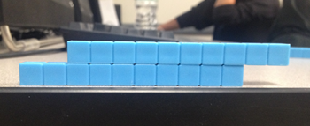
Step 2:
Students will now use 2 blocks to create this shape.
The worksheet will prompt the students to think of what they need to do to find the surface area of this peculiar shape.
Students will find multiple surface areas on the object to determine the final surface area

Slide 7
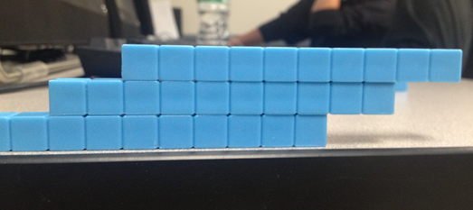
Step 3:
Students will now use 3 blocks to create this shape.
The students will record the surface area on the worksheet.

Slide 8
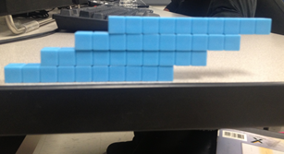
Step 4:
Lastly, the students will be using 4 blocks to create another shape.
The students will determine the surface area and record the information.

Slide 9
Step 5:
Using surface area data, the students will graph the data.
The worksheet will prompt the student to think about what the labels and information for the x and y axis.

Slide 10
Step 6:
The student will now graph the information on the graph paper provided.

Slide 11
Step 7:
The student will analyze the data they have collected, and the graph they have created to determine the pattern of the surface area.

Slide 12
Conclusion questions
Did the number of blocks affect the surface area ?
How did find the surface area of 1 block help you find the surface area of 2,3 and 4 blocks ?
What does your graph show you about the surface areas ?
With your group, think of another peculiar shape that we could find the surface area of?

Slide 13
References
www.math.com
www.basic-mathematics.com

