Slide 1
Math Club Pizza Party Superhero!!
By: Ashley Elmendorf, Stephanie Rivera, and Ashleigh Longo

Slide 2
The Problem:
You are walking down a 6-foot-wide hallway in Aquinas toward the Math Office. The walls on either side are perpendicular to the floor. You stop walking, surprised to see your way blocked by 2 maintenance ladders. One of the ladders is 10 feet long, and the other is 12 feet long. Each ladder is propped up from a corner to the opposite wall, forming an X shape. All four feet of each ladder are firmly touching either the corner or the wall.
You are four and a half feet tall, and you cannot crouch beneath the ladders because you are precariously balancing all of the pizza boxes needed for the Math Club Pizza Party. (The stack does not reach above your chin.) Can you walk beneath the ladders' meeting point to get the pizzas to the Math Office and save dozens of math majors from starvation?

Slide 3
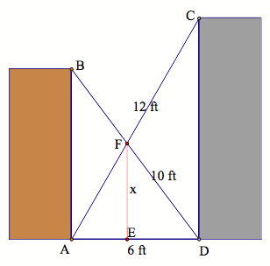
Confused? Don't know how to start?
Here's a hint!
Try a picture that includes the measurements provided. Label the dimension we are trying to find.

Slide 4
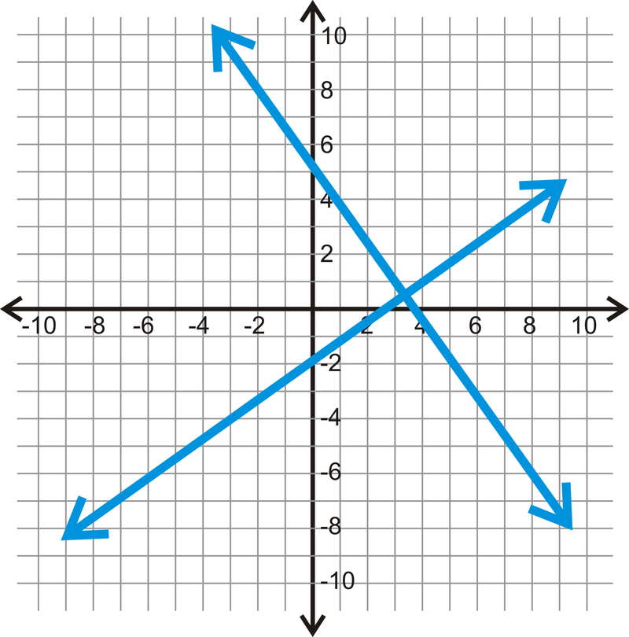
Hint 2!
What two-dimensional geometric situation do the criss-crossing ladders remind you of?
Think intersecting lines!

Slide 5
Hint 3!
How can we determine the equations of the lines represented by the ladders? What do we need to find the equation of a line?
(6,y)
(0,x)
Let's model our situation on the coordinate plane ...
... and find two points on each line.
(0,0)
(6,0)

Slide 6
Hint 4!
What shape is created by the arrangement of the ladders, walls, and floor?
What formula can be used to find the missing coordinates?
Pythagorean Theorem!!
a² + b² = c²
(0,x)
6² + x² = 10²
10 feet
x feet
36 + x² = 100
x² = 64
x = 8 feet
6 feet
(0,0)
(6,0)

Slide 7
Pythagorean Theorem continued
Find the missing coordinate of the green line.
(6,y)
Pythagorean Theorem!!
a² + b² = c²
6² + y² = 12²
12 feet
y feet
36 + y² = 144
y² = 108
y = sq.rt.(108)
(0,0)
6 feet
(6,0)

Slide 8
Finding the Equation of a Line
slope: m = y₂ - y₁
x₂ - x₁
equation of a line: y = mx + b
(6,sq.rt.(108))
(0,8)
blue line:
green line:
m = 0 - 8 = -4
6 - 0 3
m = sq.rt.(108) - 0 = sq.rt.(108)
6 - 0 6
0 = (-4/3)(6) + b
b = 8
y = (-4/3)x + 8
0 = (sq.rt.(108)/6)(0) + b
b = 0
y = (sq.rt.(108)/6)x
(0,0)
(6,0)

Slide 9
Finding the Intersection Point of Two Lines
y = (-4/3)x + 8
y = (sq.rt.(108)/6)x
(-4/3)x + 8 = (sq.rt.(108)/6)x
8 = (4/3)x + (sq.rt.(108)/6)x
8 = (8/6)x + (sq.rt.(108)/6)x
8 = [(8 + sq.rt.(108))/6]x
x = 48 / (8 + sq.rt.(108))
y = (48*sq.rt.(108)/6)
6(8 + sq.rt.(108))
Intersection Point is approx (2.6098 feet, 4.5203 feet)

Slide 10
Can We Get the Pizza to the Party?
Which coordinate of the intersection point do we need?
We need the y-coordinate.
Can we get the pizzas to the Math Club Pizza Party?
Yes! The person carrying the pizzas is 4.5 feet tall, and there are 4.5203 feet of space beneath the ladders.

